Slide 1
AS, ALevel
ART& DESIGN

Slide 2

Please view this short video about the creative industries

Slide 3
What will be especially important for me to succeed on this course?
You need to have shown a good level of artistic skill at GCSE and enjoy art. You must have a desire to learn new skills and develop your visual language. You should be a independent, hard worker who is prepared to carry out your ideas resulting in ambitious, creative and exciting work with the capability to work under your own initiative.
You could go on to take a higher qualification in Art & Design such as A-level. Skills and creativity promoted by taking Art & Design are important in various career paths.
What qualification will the course lead to?
I wonder if this will get an A*?
How would it help me in the future?
The study of Art can help you develop transferable skills that you can take to any career or job. It will help: your research skills; help you to problem solve; develop your ability to work independently; train you to share ideas visually and orally, to be innovative, creative and reflective in your work, consider audience, consumer and/or function in the presentation of your work.

Slide 4
St Louis A Level
ART & DESIGN RESULTS
AS
2023 A*-C 100%
2022 A*-C 100%
2021 A*-C 100%
A2
2023 A*-C 100%
2022 A*-C 100%
2021 A*-C 100%

Slide 5
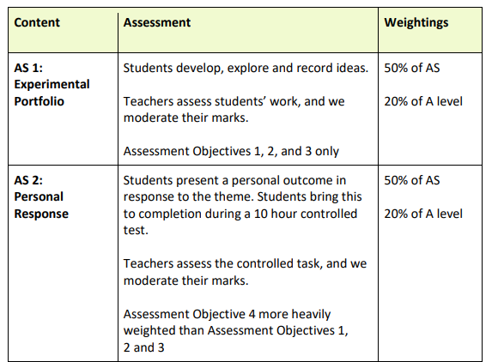
Course content AS
AS1 Experimental portfolio
Completed in school and at home
AS2 Personal Response
Completed in school and at home
Final outcome completed in controlled 10 hr Exam conditions in school

Slide 6
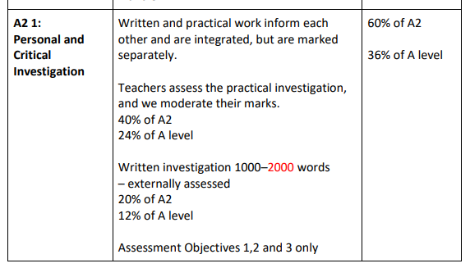
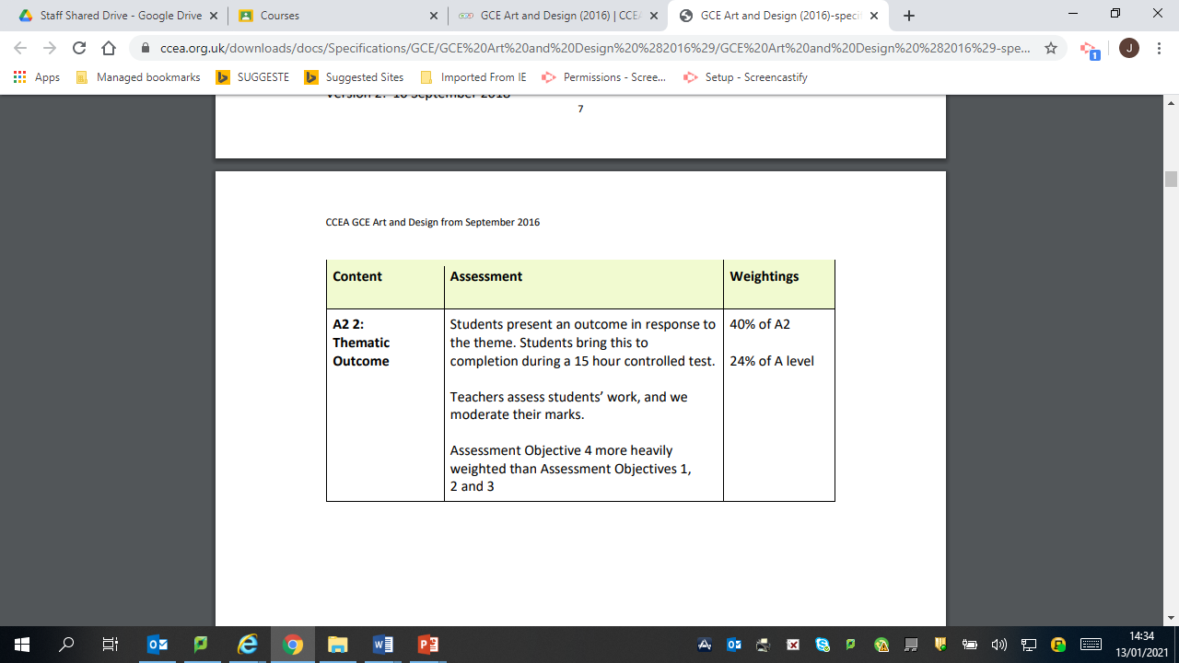
A2 Course Content
A21 Personal and Critical Investigation
Completed in school and at home
A2 2 Thematic Outcome
Completed in school and at home
Final outcome completed in controlled 15 hr Exam conditions in school

